Slide 1
“Old Age” burials throughout the years

Slide 2
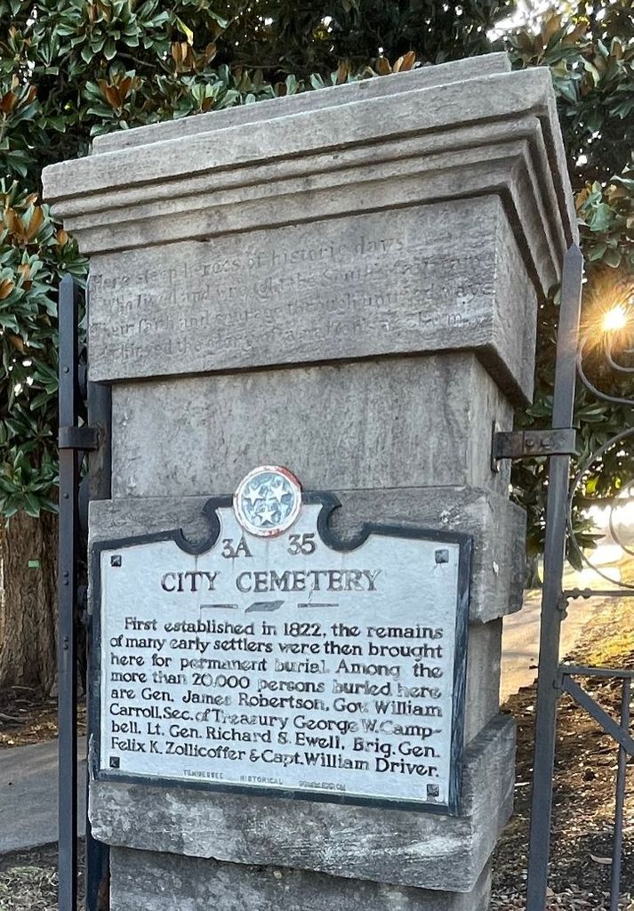
What are we looking for?
Analyze the City Cemeteries data set to take a deeper look into every death/burial that was to be considered “old age” or within the 65+ age group.
View how the data progressed through the years and see if there were any major contributing factors to changes discovered.
What do the historical records classify as a cause of burial/death being Old Age exactly?
Where there any advancements made medically to change the data as it progressed through the years?

Slide 3
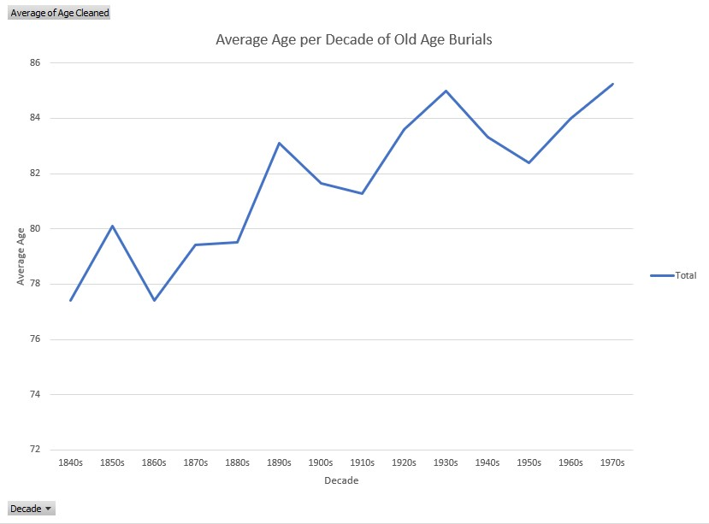
Average burial age by decade
- Youngest “Old Age” burial was 50 years old.
- Burial was for a slave of J.W Martin by the name of Barby in 1848.
- Oldest burial was 109 years old.
- Burial was for Jenny McFarland in 1870.

Slide 4
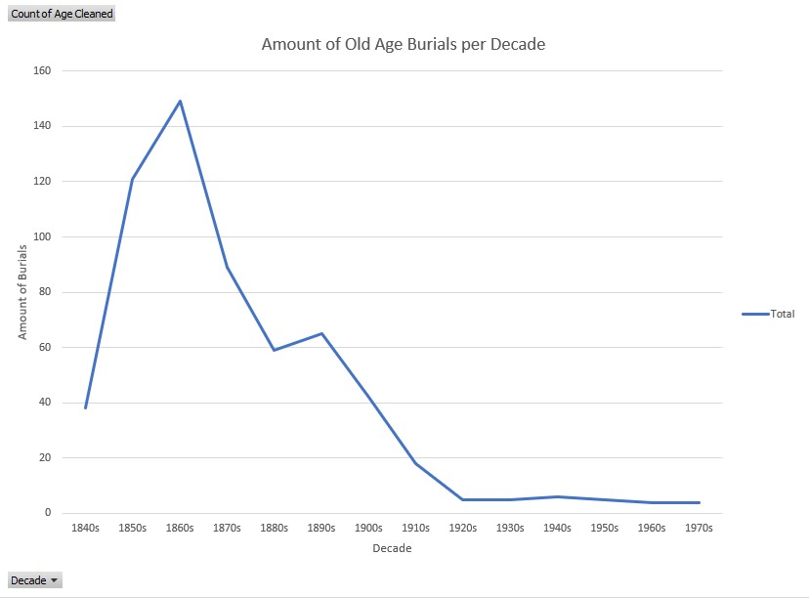
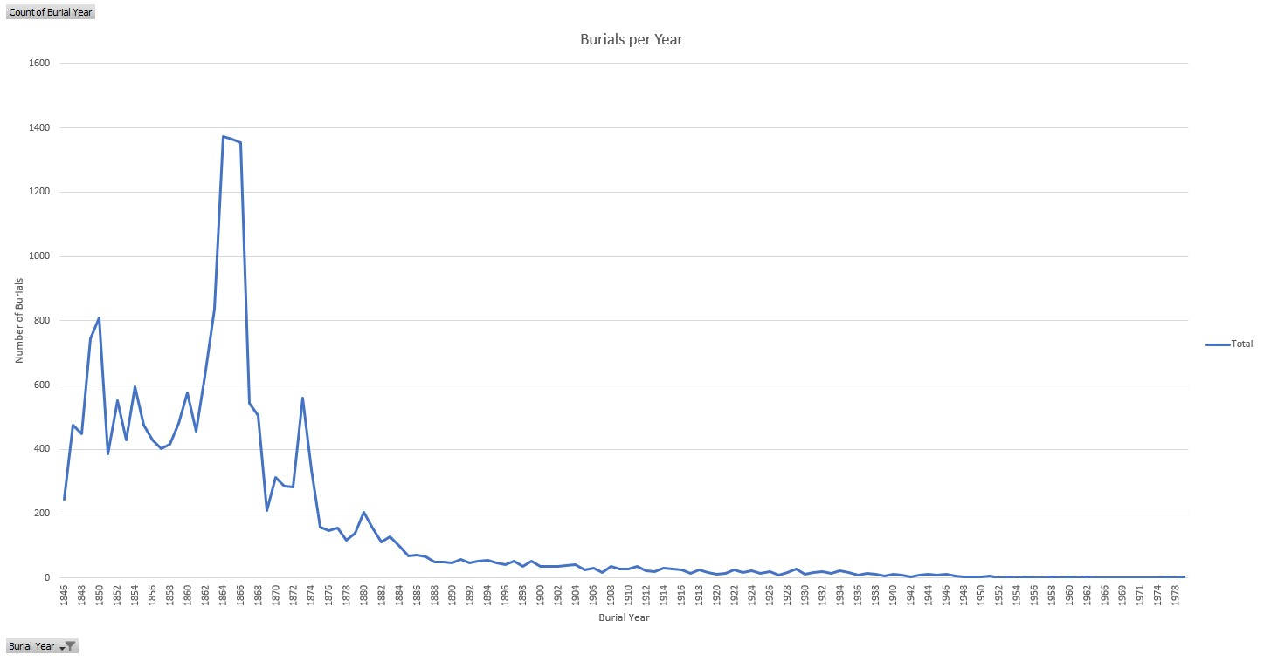
Number of burials per decade
The total amount of “Old Age” burials severely decreases, despite people living longer as the years go on.
Trend follows a very similar path as the total number of burials in this cemetery throughout the years recorded.

Slide 5
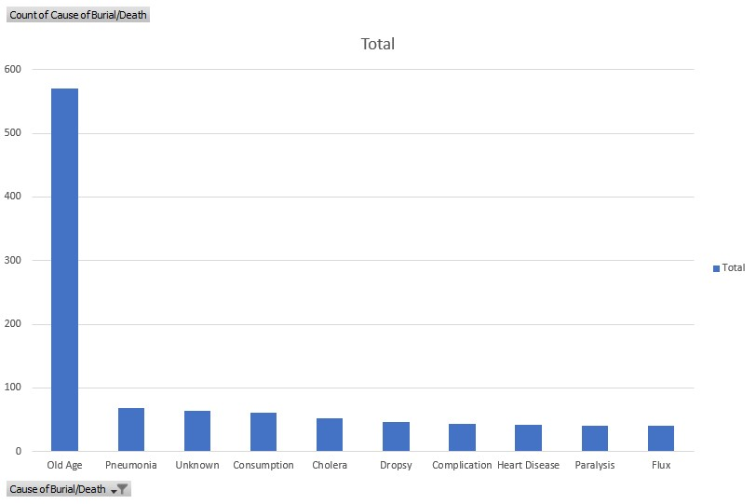
Other causes of death/burial
Through the full timeframe of our data, Old Age was by far the most common reason of death for the 65+ age group.
Other causes of death did decrease while the decades progressed, hinting at advancements in medical technology and treatment.
Some diseases, such as Dropsy and Flux (Dysentery), were not listed as a cause of burial past the year 1900, being eliminated in the 65+ age group completely.

Slide 6
Reasons for the increase in lifespans?
One of the biggest contributing factors to the increase in the average age among this group could be the general improvement of quality of life.
Multiple medical advancements were made throughout this timespan. Including the invention of the Cholera vaccine in 1884, antiseptic surgeries in 1867 and reliable blood transfusions in 1901.
Overall, as humans became more advanced throughout history, we also were more successful in making sure that people lived longer, and healthier lives.

Slide 7
Questions?

